Slide 1

Introducing {workboots}
Generate prediction intervals from tidymodel workflows
Mark Rieke
2022-07-27
<link to slides>

Slide 2


Slide 3
paint brush with bluetooth

Slide 4
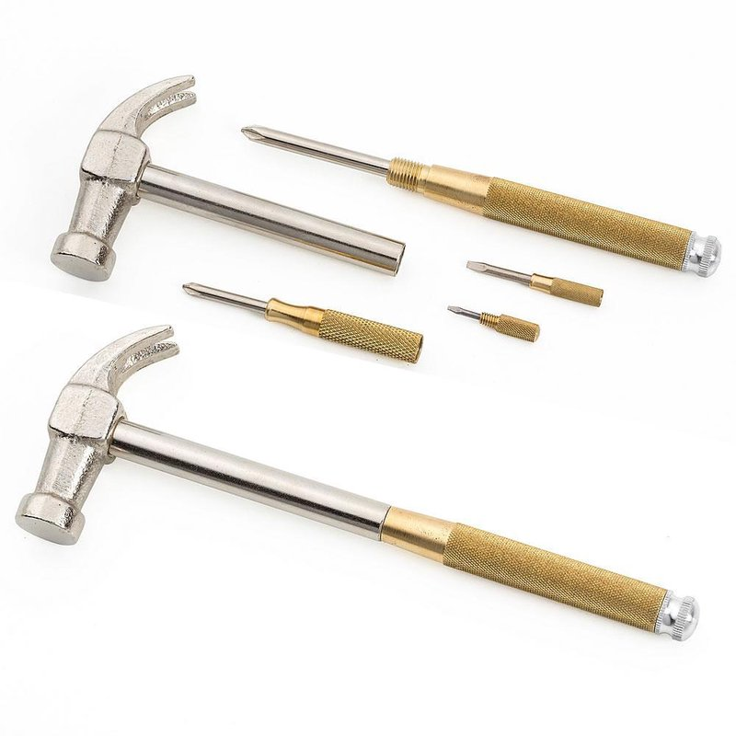

Slide 5
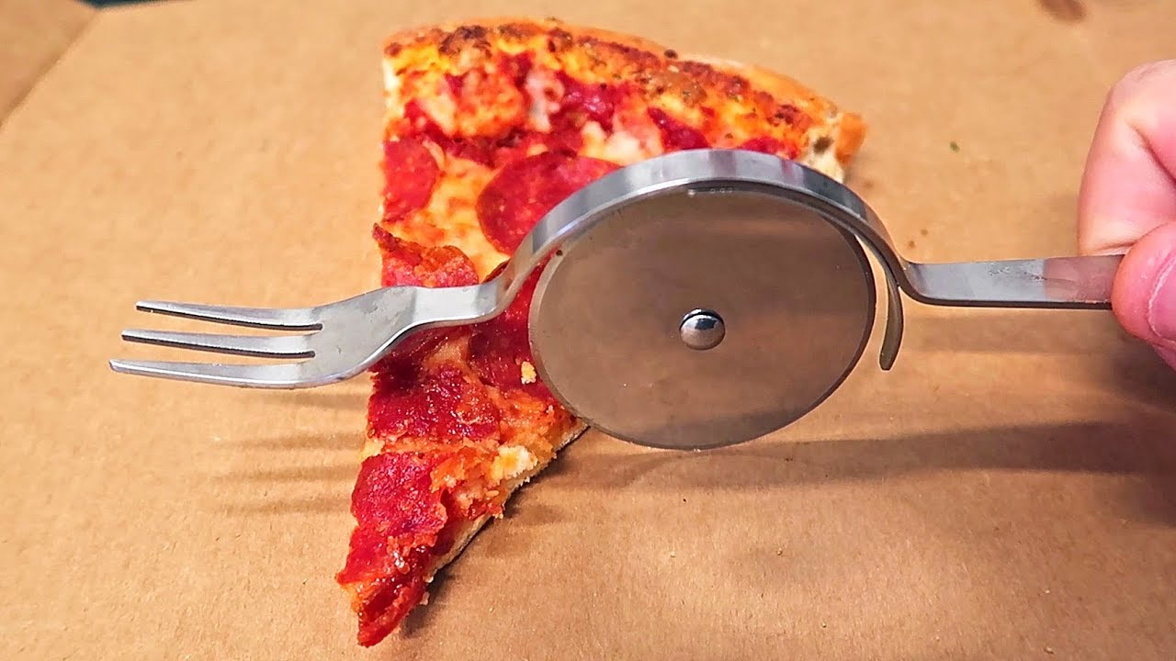

Slide 6
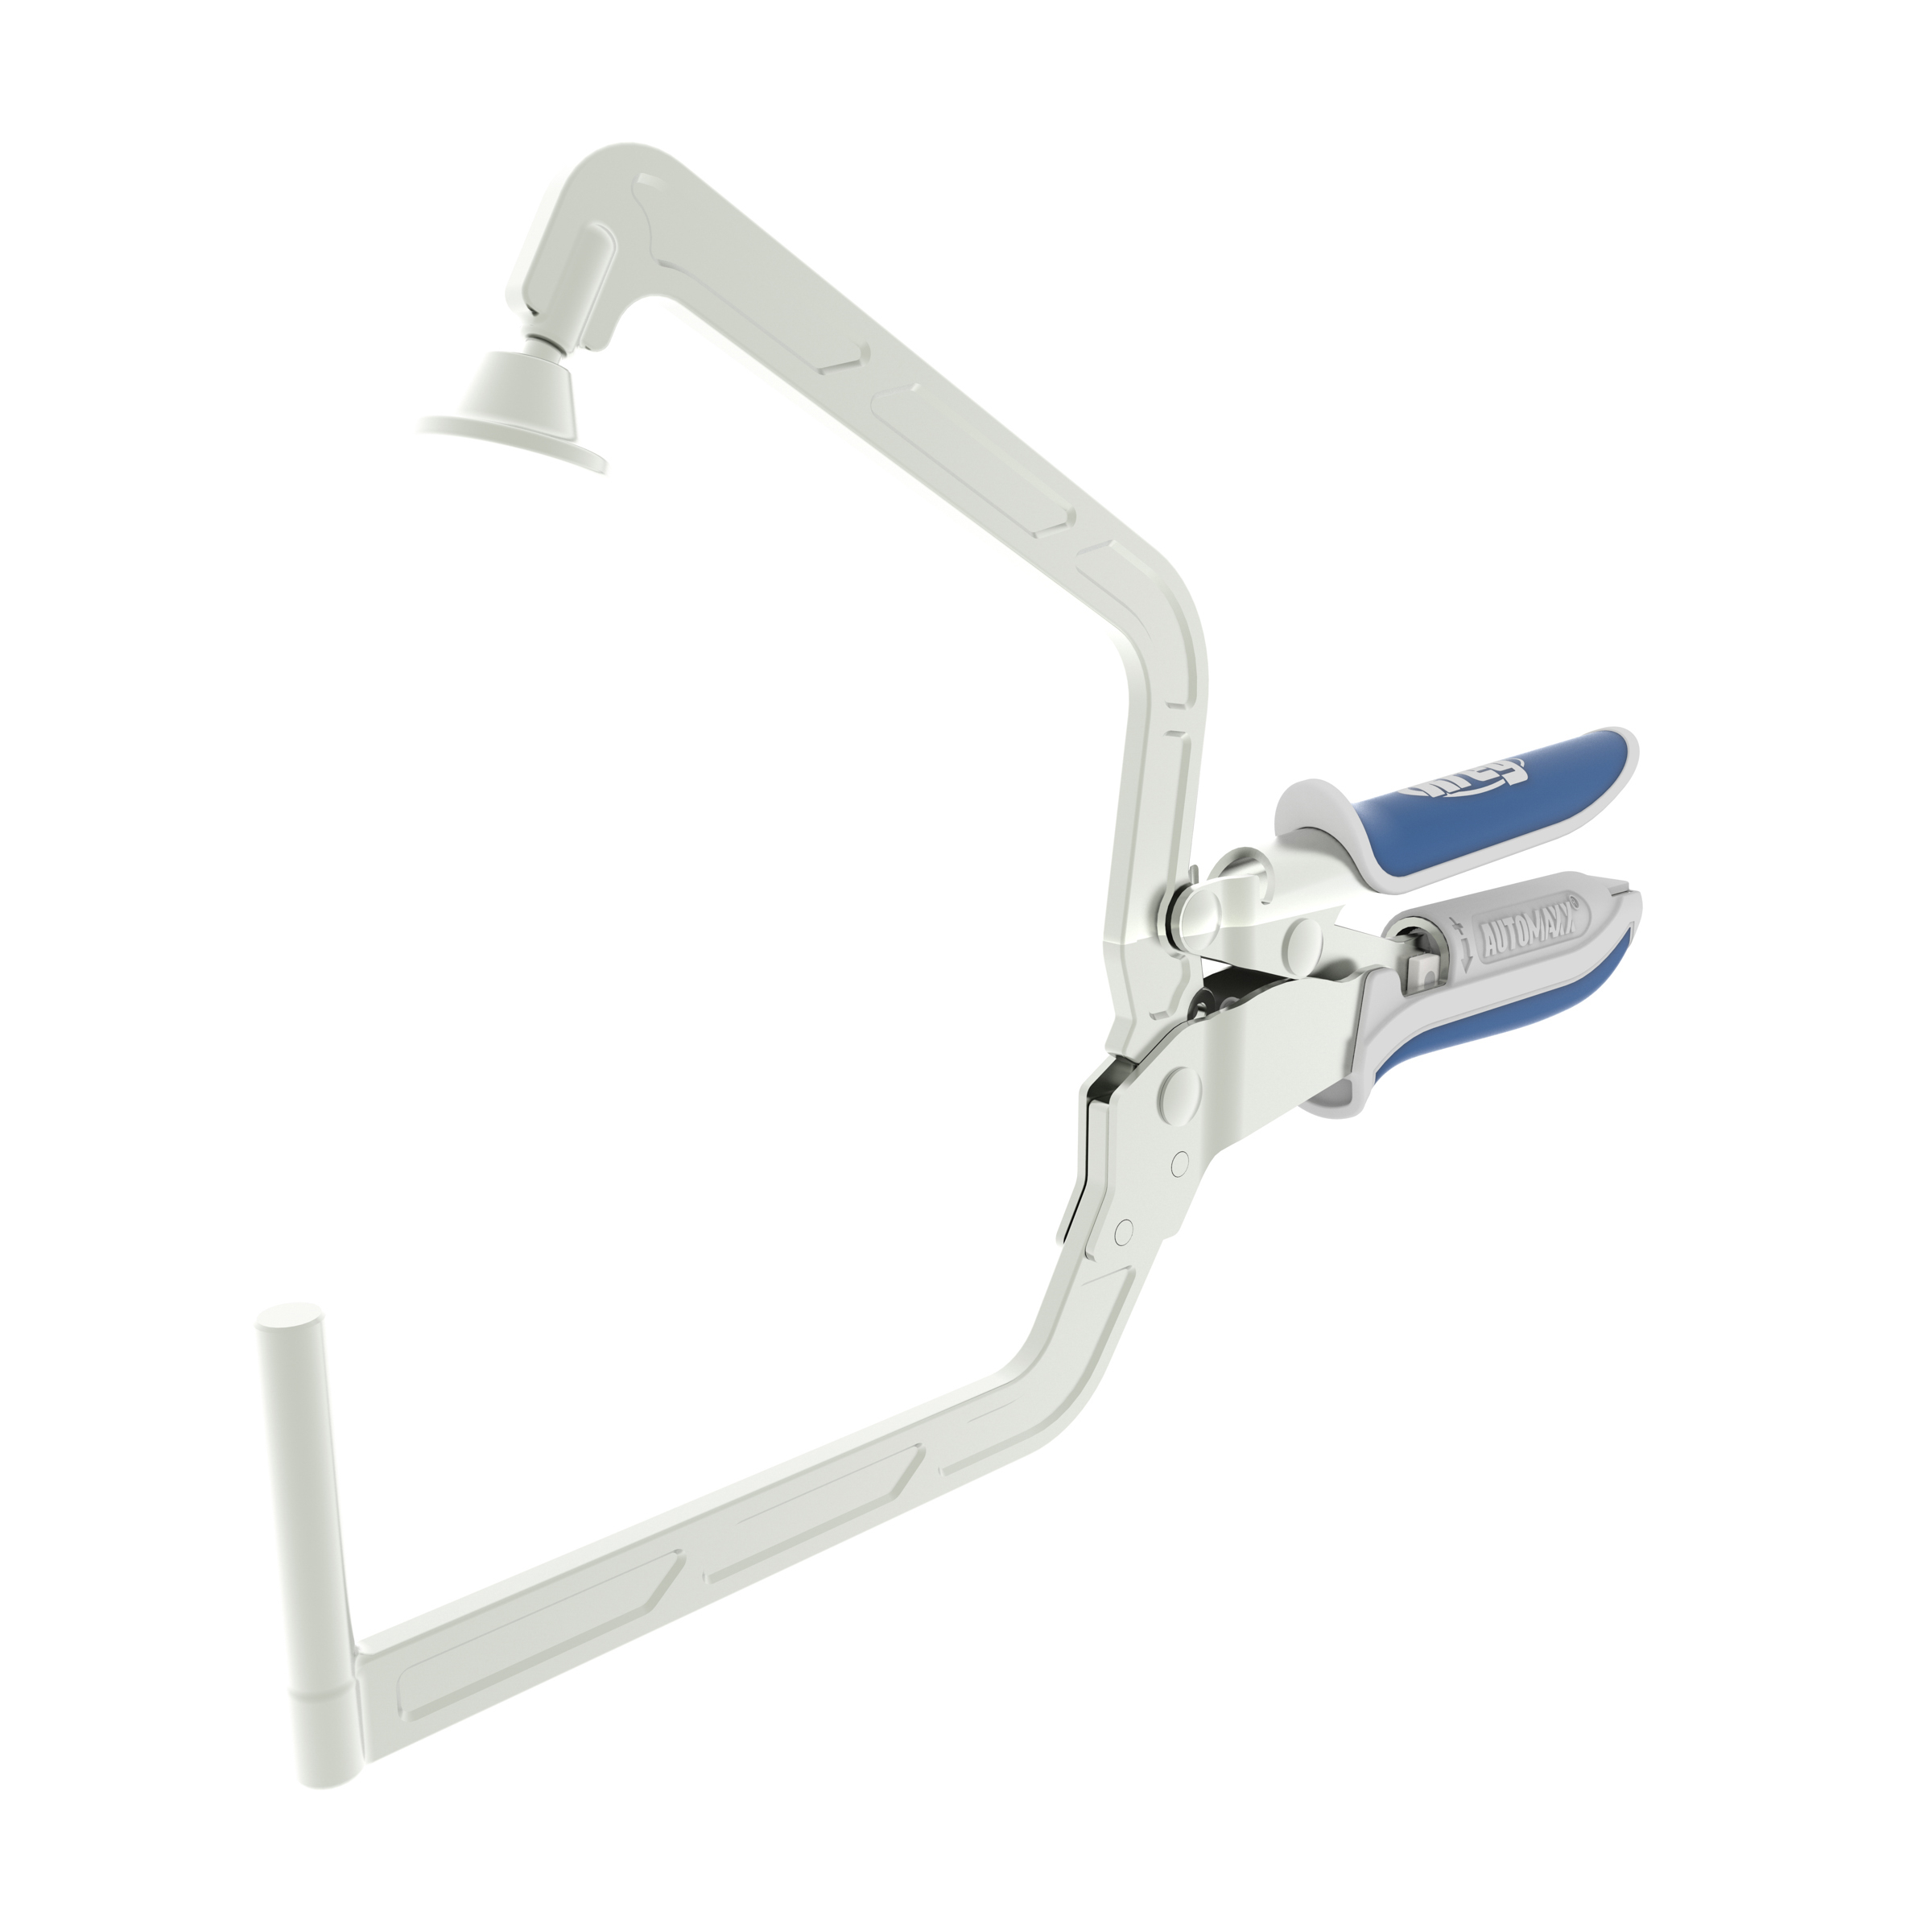
Update with mine later

Slide 7
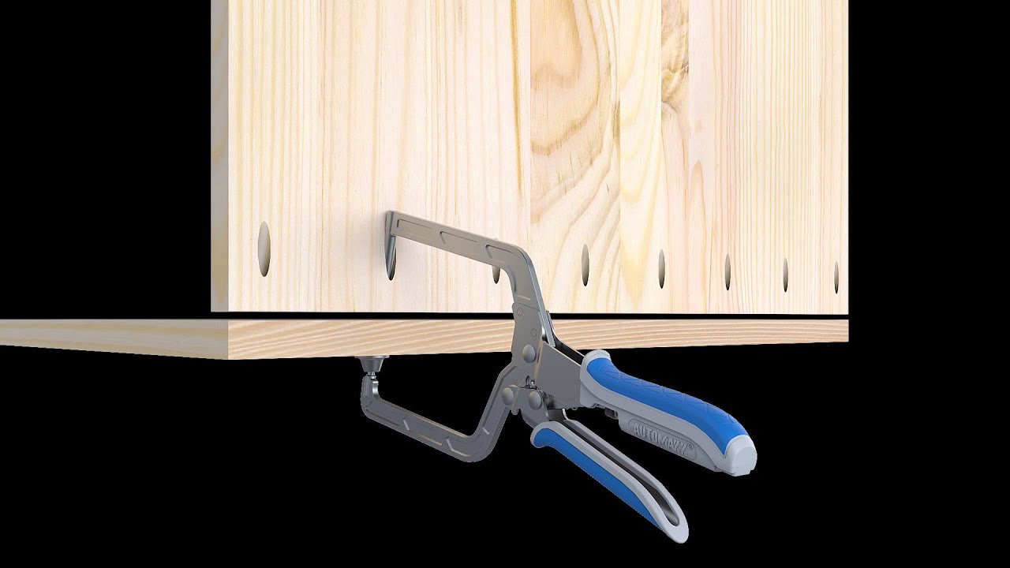
Update with mine later

Slide 8
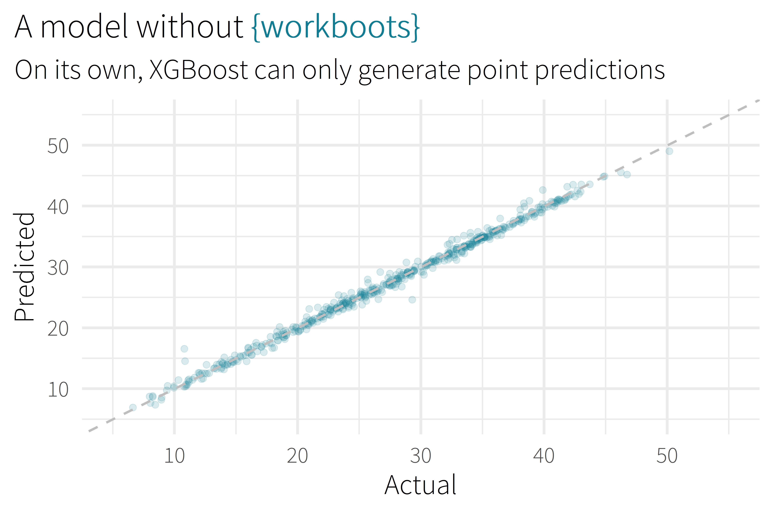

Slide 9
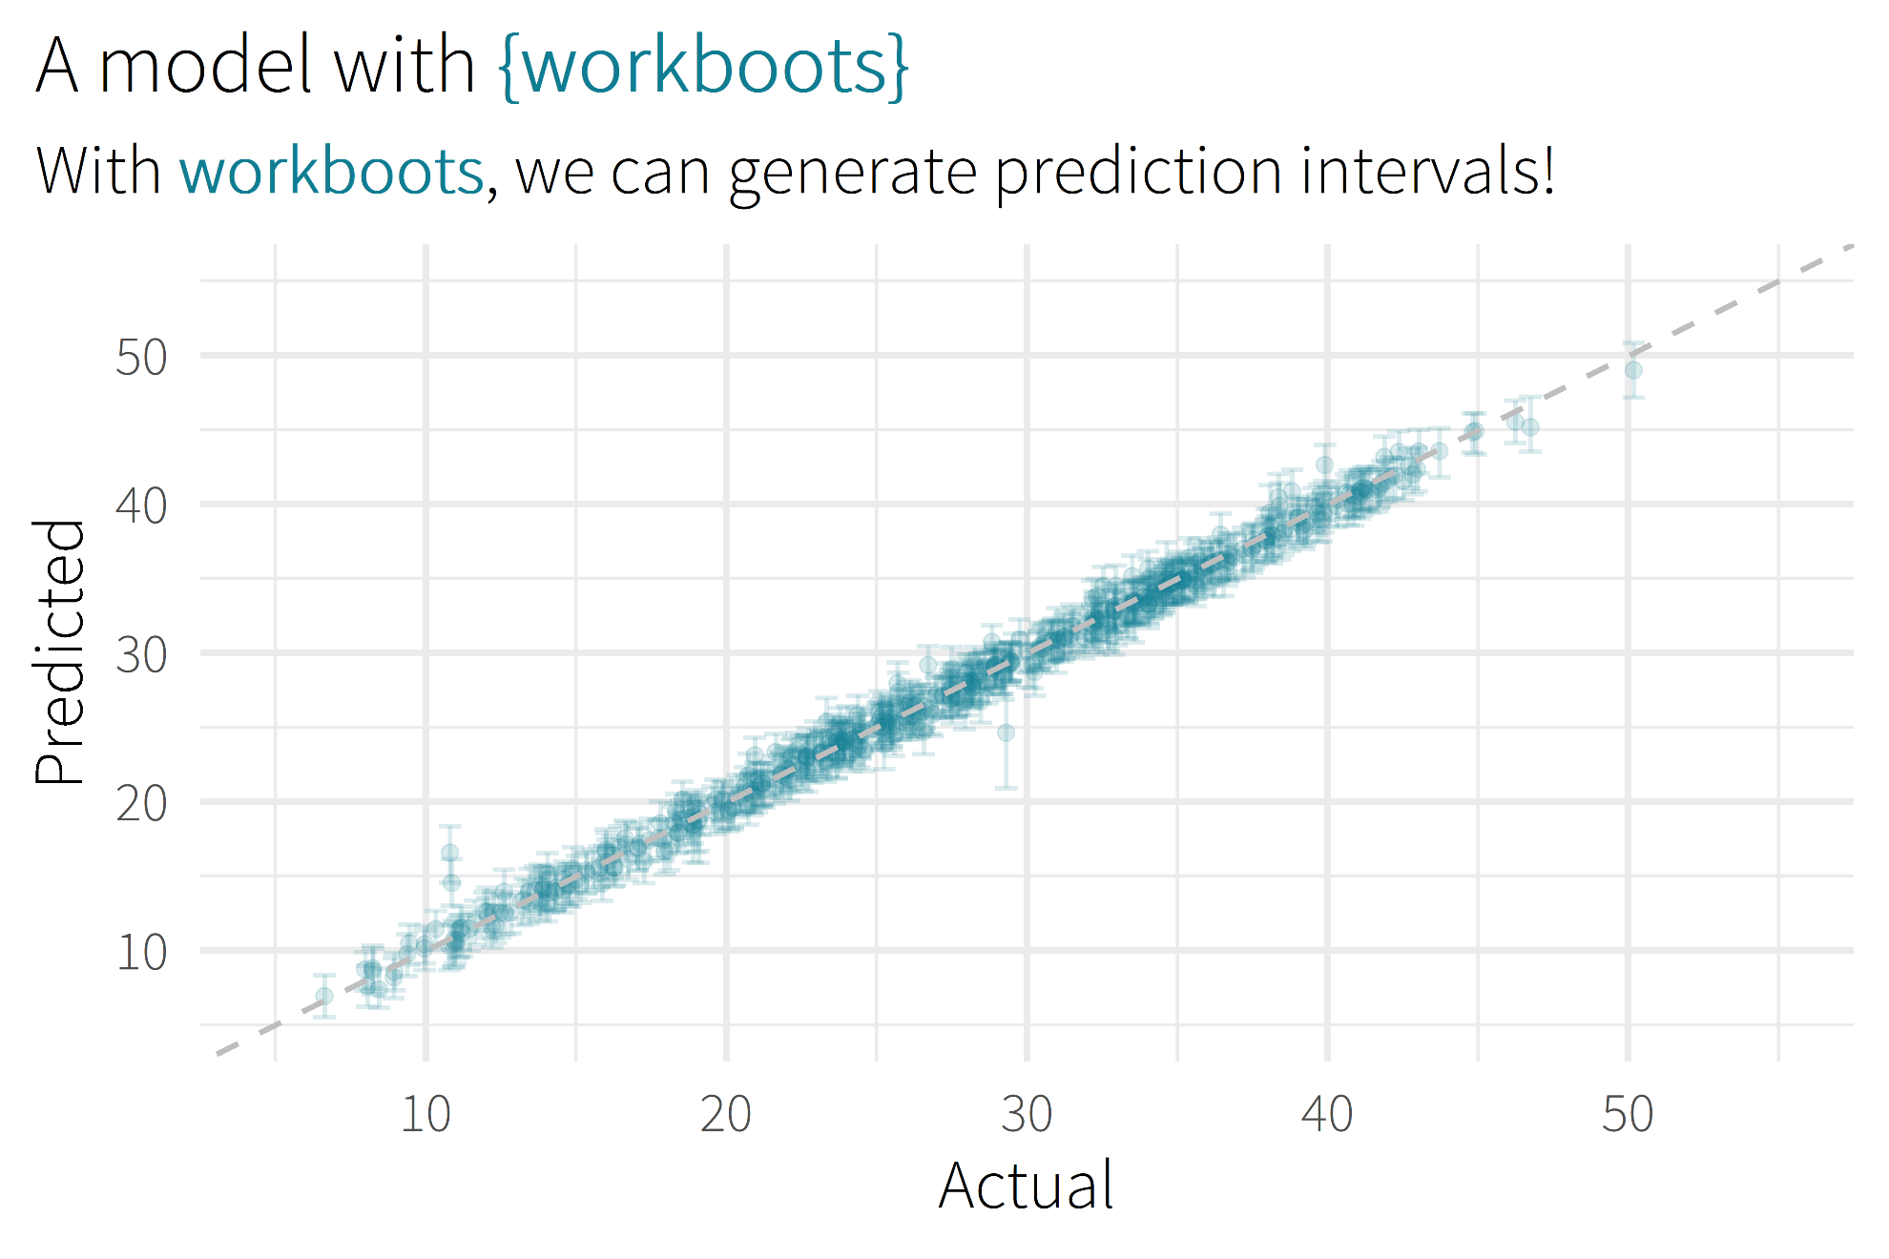

Slide 10

Motivation/Background

Slide 11
Package Overview

Slide 12
“how this works” section
High-level review of methodology
Link to more detail

Slide 13
using workboots
Set up a workflow
Generate predictions
Summarise results

Slide 14
set up a workflow
library(tidymodels)

Slide 15
set up a workflow
library(tidymodels)
# setup our data
data(“penguins”)
penguins <- penguins %>% drop_na()

Slide 16
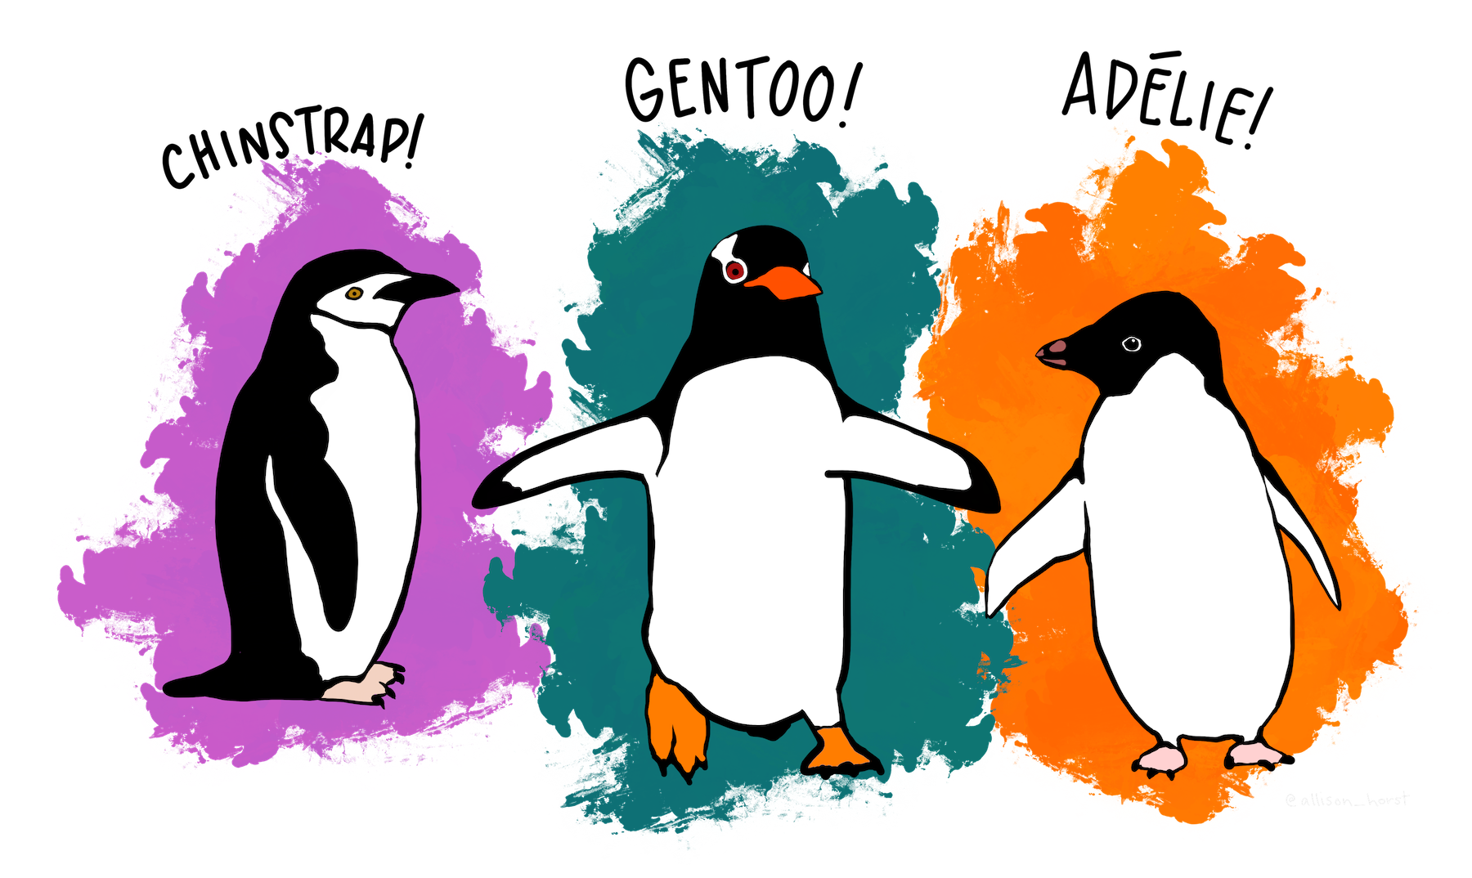
set up a workflow
library(tidymodels)
# setup our data
data(“penguins”)
penguins <- penguins %>% drop_na()

Slide 17
set up a workflow
library(tidymodels)
# setup our data
data(“penguins”)
penguins <- penguins %>% drop_na()
set.seed(123)
penguins_split <- initial_split(penguins)
penguins_test <- testing(penguins_split)
penguins_train <- training(penguins_split)

Slide 18
set up a workflow
# setup a basic preprocessing recipe
penguins_rec <-
recipe(body_mass_g ~ ., data = penguins_train) %>%
step_dummy(all_nominal())

Slide 19
set up a workflow
# setup a basic preprocessing recipe
penguins_rec <-
recipe(body_mass_g ~ ., data = penguins_train) %>%
step_dummy(all_nominal())
# put together a workflow
penguins_wf <-
workflow() %>%
add_recipe(penguins_rec) %>%
add_model(boost_tree(“regression”))
Notes:
Notes
All tuning parameters finalized (in this case, we’re just using the defaults)
Workflow hasn’t been fit

Slide 20
generate predictions
library(workboots)

Slide 21

generate predictions
library(workboots)

Slide 22
generate predictions
library(workboots)
# generate a bootstrap prediction interval
set.seed(345)
penguins_preds <-
penguins_wf %>%
predict_boots(
n = 2000,
training_data = penguins_train,
new_data = penguins_test,
interval = “prediction”
)

Slide 23
generate predictions
library(workboots)
# generate a bootstrap prediction interval
set.seed(345)
penguins_preds <-
penguins_wf %>%
predict_boots(
n = 2000,
training_data = penguins_train,
new_data = penguins_test,
interval = “prediction”
)
Notes:
Number of bootstrap predictions to make

Slide 24
generate predictions
library(workboots)
# generate a bootstrap prediction interval
set.seed(345)
penguins_preds <-
penguins_wf %>%
predict_boots(
n = 2000,
training_data = penguins_train,
new_data = penguins_test,
interval = “prediction”
)
Notes:
Supply both our training data and new data in one step, since we’ll be fitting and predicting with one function call

Slide 25
generate predictions
library(workboots)
# generate a bootstrap prediction interval
set.seed(345)
penguins_preds <-
penguins_wf %>%
predict_boots(
n = 2000,
training_data = penguins_train,
new_data = penguins_test,
interval = “prediction”
)
Notes:
Supply both our training data and new data in one step, since we’ll be fitting and predicting with one function call

Slide 26
generate predictions
penguins_preds
#> # A tibble: 84 x 5
#> rowid .preds
#> <int> <list>
#> 1 1 <tibble [2,000 x 2]>
#> 2 2 <tibble [2,000 x 2]>
#> 3 3 <tibble [2,000 x 2]>
#> 4 4 <tibble [2,000 x 2]>
#> 5 5 <tibble [2,000 x 2]>
#> # ... With 79 more rows
Notes:
Returns a tibble with 2000 nested predictions for each observation. In this case, each row represents a penguin in the penguins_test dataset.

Slide 27
summarise results
penguins_preds %>%
summarise_predictions() %>% select(-.preds)
#> # A tibble: 84 x 5
#> rowid .pred .pred_lower .pred_upper
#> <int> <dbl> <dbl> <dbl>
#> 1 1 3465. 2913. 3994.
#> 2 2 3535. 2982. 4100.
#> 3 3 3604. 3050. 4187.
#> 4 4 4157. 3477. 4764.
#> 5 5 3868. 3305. 4372.
#> # ... With 79 more rows
Notes:
Can pass this to summarise_predictions(), which appends each prediction with the median, upper and lower interval bounds.

Slide 28
generate predictions
library(workboots)
# generate a bootstrap prediction interval
set.seed(345)
penguins_preds <-
penguins_wf %>%
predict_boots(
n = 2000,
training_data = penguins_train,
new_data = penguins_test,
interval = “prediction”
)

Slide 29
generate predictions
library(workboots)
# generate a bootstrap prediction interval
set.seed(345)
penguins_preds <-
penguins_wf %>%
predict_boots(
n = 2000,
training_data = penguins_train,
new_data = penguins_test,
interval = “prediction”
)
Notes:
By default, predict_boots() will generate a prediction interval

Slide 30
generate predictions
library(workboots)
# generate a bootstrap prediction interval
set.seed(345)
penguins_preds <-
penguins_wf %>%
predict_boots(
n = 2000,
training_data = penguins_train,
new_data = penguins_test,
interval = “confidence”
)
Notes:
But we can also generate

Slide 31
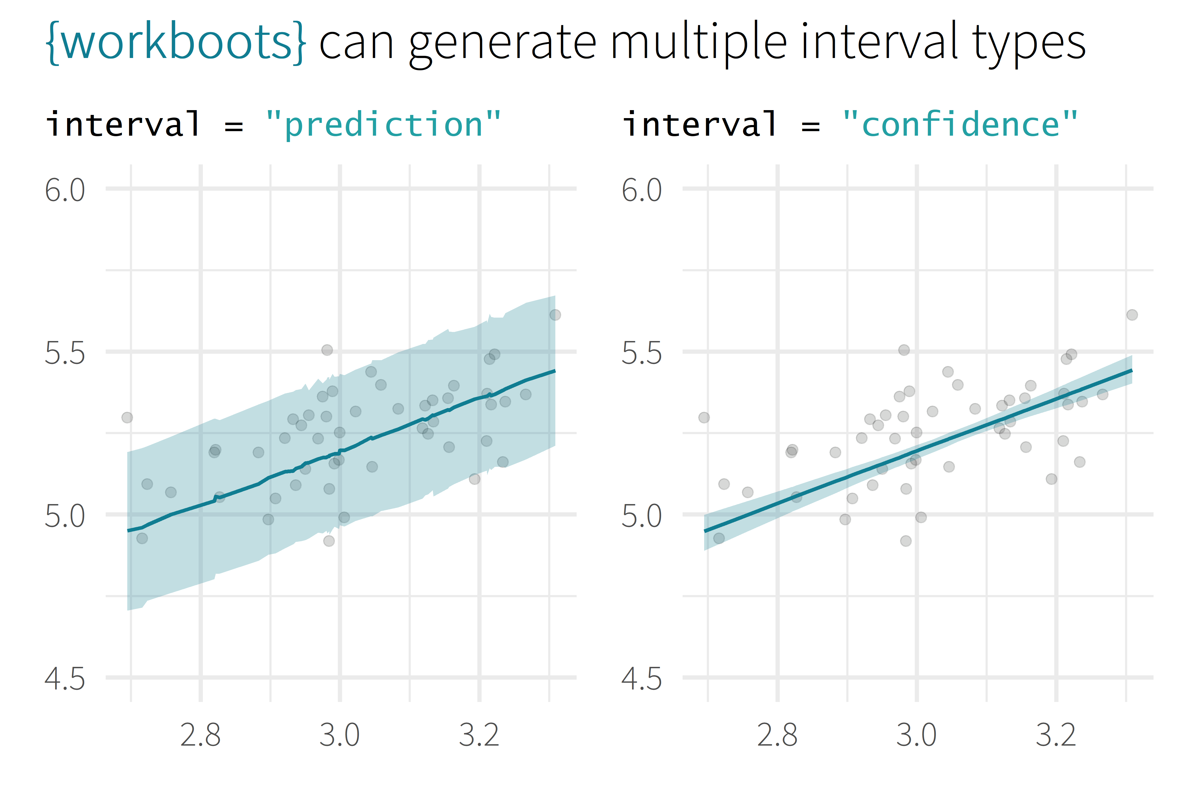
log10(Sale_Price)
log10(First_Flr_SF)

Slide 32
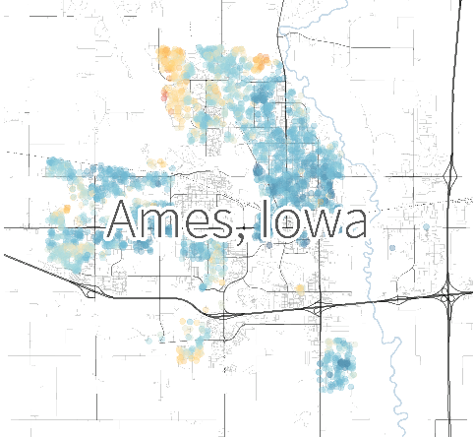
log10(Sale_Price)
log10(First_Flr_SF)

Slide 33
generate importances
# generate a bootstrap variable importances
set.seed(345)
penguins_vi <-
penguins_wf %>%
vi_boots(
n = 2000,
training_data = penguins_train
)

Slide 34
generate importances
penguins_vi
#> # A tibble: 8 x 2
#> variable .importances
#> <int> <list>
#> 1 flipper_length_mm <vi [2,000 x 2]>
#> 2 species_Gentoo <vi [1,928 x 2]>
#> 3 bill_length_mm <vi [2,000 x 2]>
#> 4 bill_depth_mm <vi [2,000 x 2]>
#> 5 sex_male <vi [2,000 x 2]>
#> # ... With 3 more rows

Slide 35
generate importances
penguins_vi %>%
summarise_importance() %>% select(-.importances)
#> # A tibble: 8 x 2
#> variable .importance .importance_lower
#> <int> <dbl> <dbl>
#> 1 flipper_length_mm 0.464 0.254
#> 2 species_Gentoo 0.402 0.044
#> 3 bill_length_mm 0.045 0.027
#> 4 bill_depth_mm 0.040 0.024
#> 5 sex_male 0.046 0.020
#> # ... With 3 more rows, and 1 more variable:
#> # .importance_upper <dbl>

Slide 36
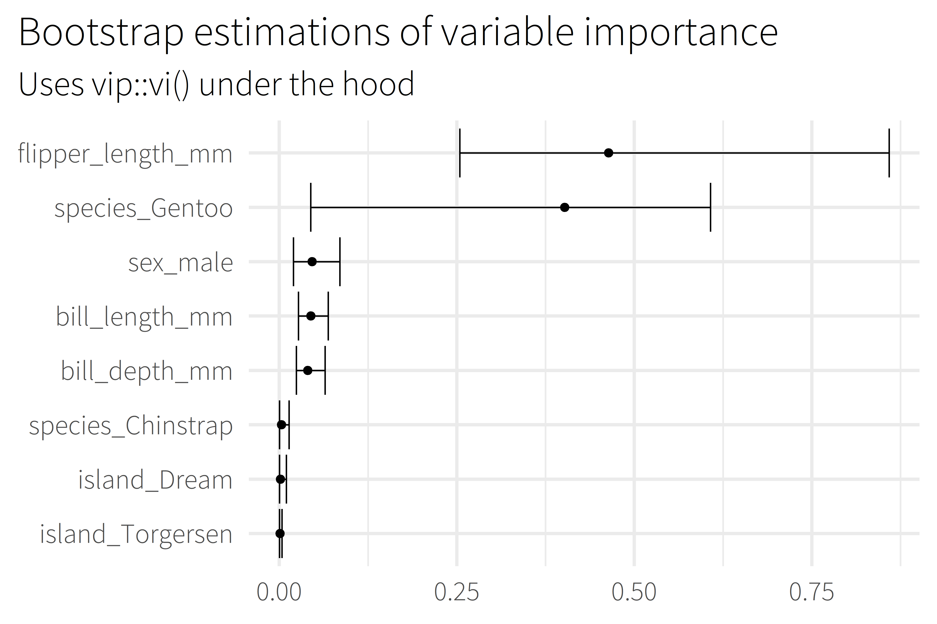
Notes:
Uses the vip package under the hood to estimate model-specific importance.
Some model types aren’t supported by vip

Slide 37
Backup

Slide 38
overview
Selling Point
About me
Motivation / Background
Package overview
Cost of doing business
(1 min)
(2 min)
(5 min)
(5 min)
(5 min)

Slide 39








about me
BSME, University of Tulsa
Sr. CX Analyst, MHHS
@markjrieke

Slide 40
“I use R and tidymodels to provide actionable insight from patient survey data.”

Slide 41
plot/plot/plot

Slide 42
plot/plot/plot
context/context/context

Slide 43

5.0 (19)
4.6 (2,280)

Slide 44
What is the range of possible outcomes?
How important is each variable in the model?

Slide 45

lm()
me
XGBoost

Slide 46
Prediction Intervals

Slide 47
Prediction Intervals
Powerful Models

Slide 48
Prediction Intervals
{workboots}
Powerful Models

Slide 49
Prediction Intervals
{workboots}
Powerful Models
via bootstrap resampling

